Slide 1
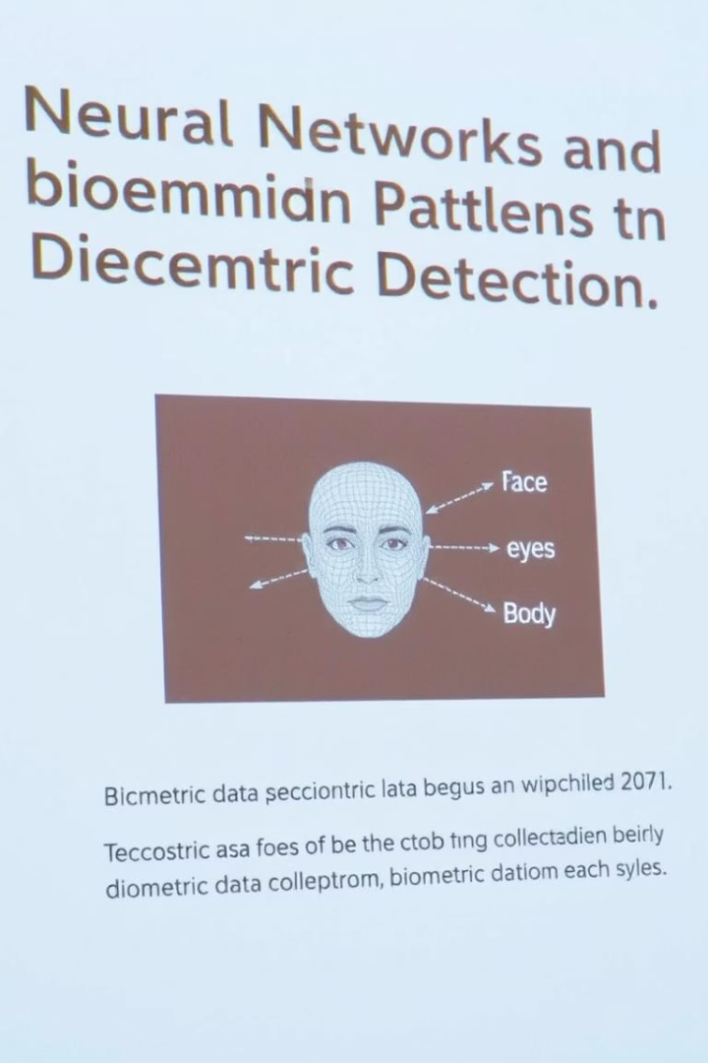
Advance Deception Detection using Multimodal Analysis
ID - 3634
Swayam Singh, Krisha Patel, Priyanshi Airen, Aditya Kasar, Sakshi Indolia, Shailendra Aote
SVKM's NMIMS, Navi Mumbai
ADD

Slide 2

Problem Statement & Motivation
Human Limitations
Humans often fail to reliably detect lies.
Traditional Methods
Polygraphs and similar tools exhibit high error rates.
Deep Learning Advantage
Enables objective and multimodal lie detection.
Our Goal
Real-time, accurate detection using text, speech, and vision.
ADD

Slide 3
Datasets: Dolos & Politifact
Dolos Dataset
Politifact Dataset
Combined Use
1,680 labeled video clips
11,188 text claims
Supports model training across text, audio, and video.
Truth/lie labels
Veracity labels
Facial, vocal, and gestural features
ADD

Slide 4
System Architecture (Multimodal Pipeline)
Text Processing
Tokenizer then BiLSTM network for sequence modeling.
Audio Processing
Extraction of pitch, loudness, fillers using PyAudio and deep model.
Video Processing
OpenCV detects eye aspect ratio and gestural cues.
Fusion & Output
Dense layer aggregates features; Softmax yields predictions.
ADD

Slide 5
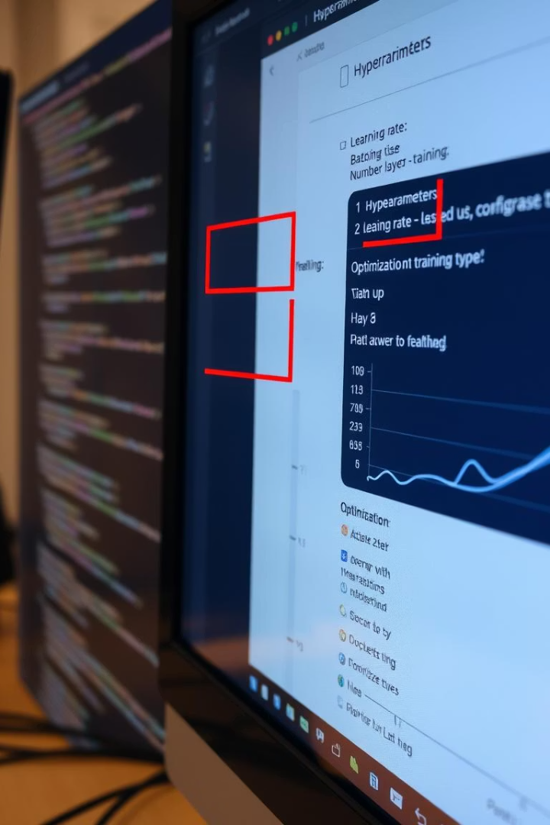
Model Configuration
Optimizer & Learning
Adam optimizer with learning rate 0.001 ensures steady updates.
Training Setup
Binary crossentropy loss; 30 epochs with early stopping after 5.
Batch & Activation
Batch size 32; ReLU hidden layers; Softmax classification output.
Data Split
Training/testing data split at 80/20 ratio for validation quality.

Slide 6
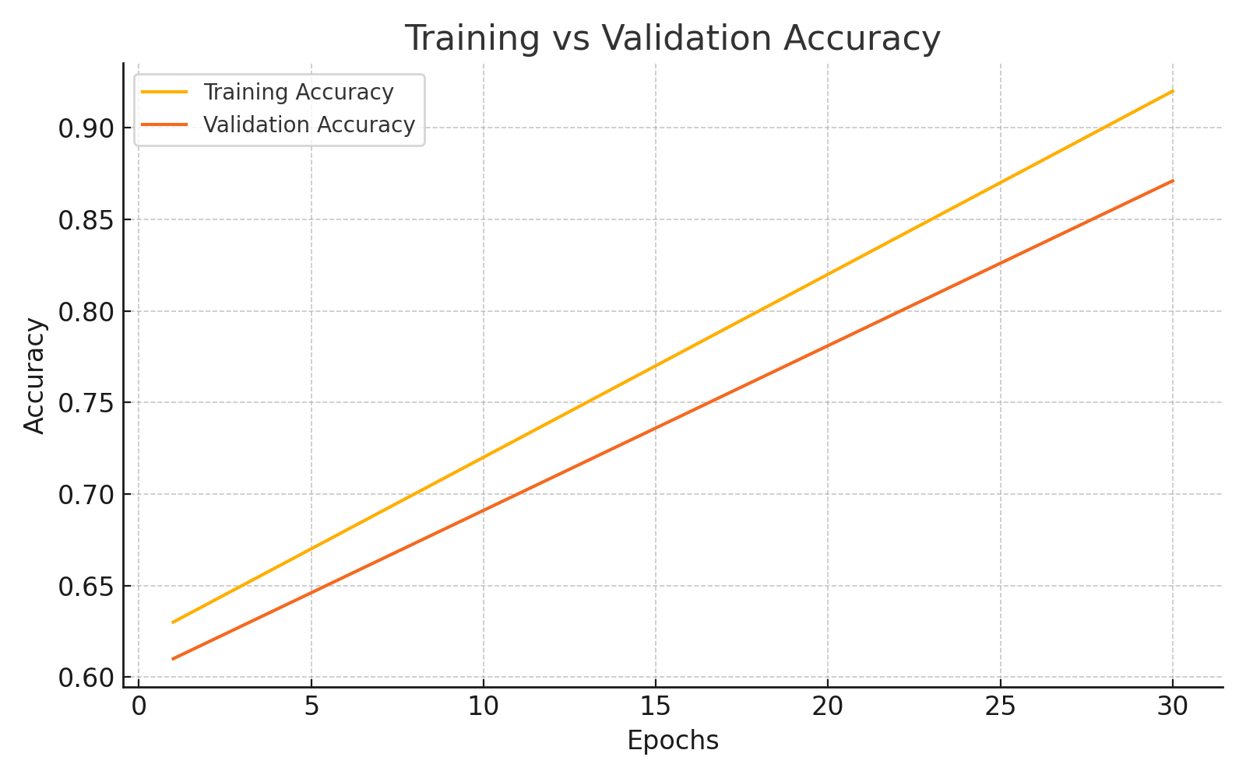
Training vs Validation Accuracy
Steady increases in accuracy demonstrate effective learning and generalization over 30 epochs.
ADD

Slide 7
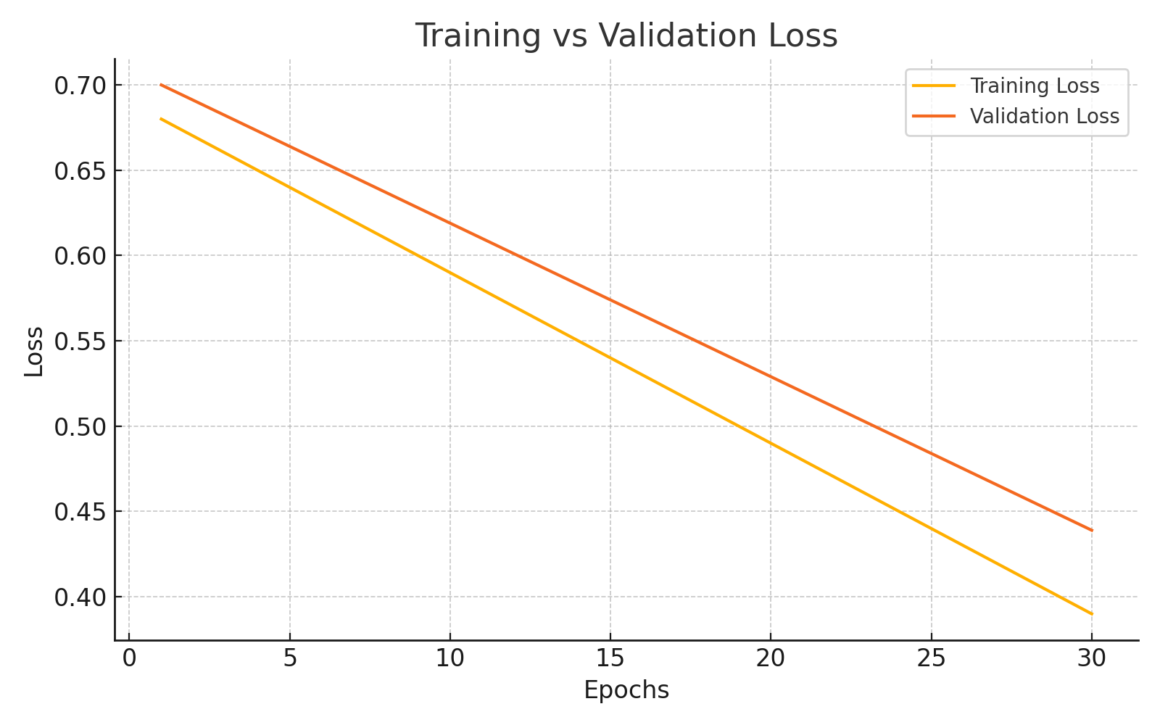
Training vs Validation Loss
Converging loss patterns indicate stable model optimization and minimal overfitting.
ADD

Slide 8
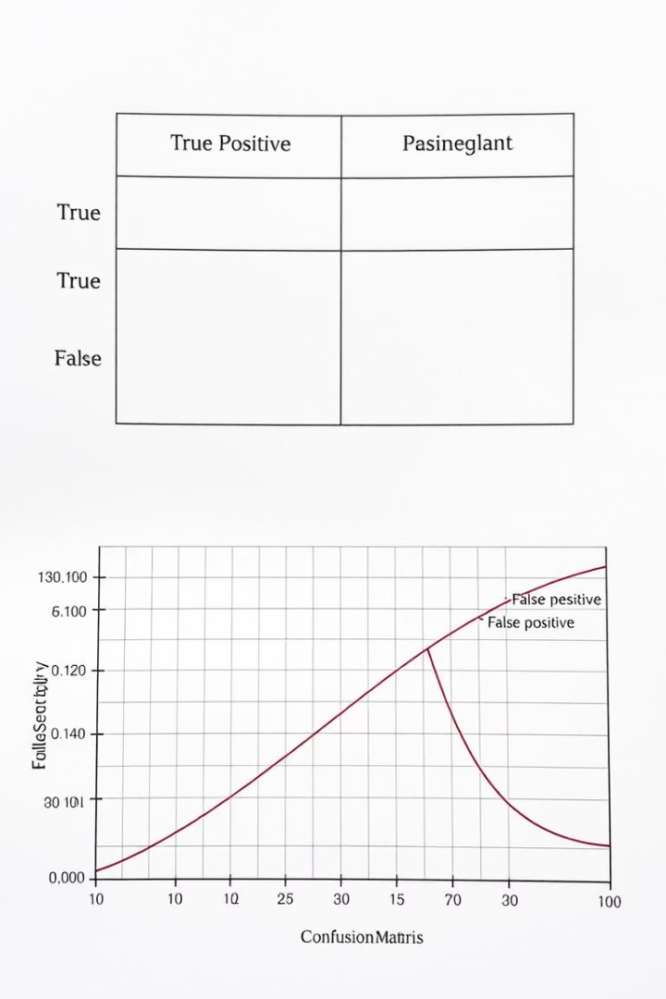
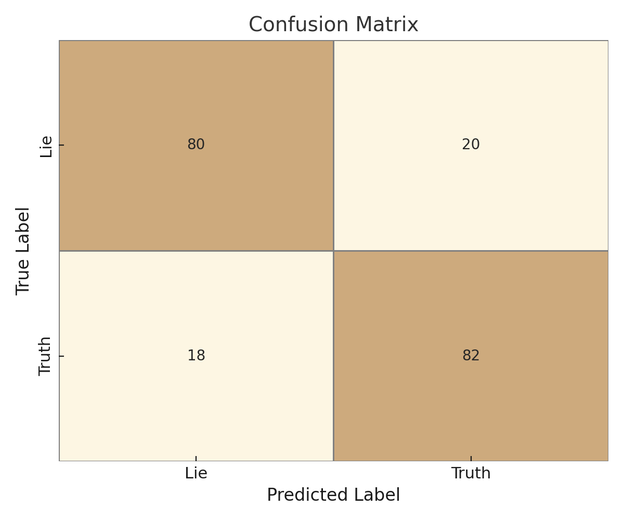
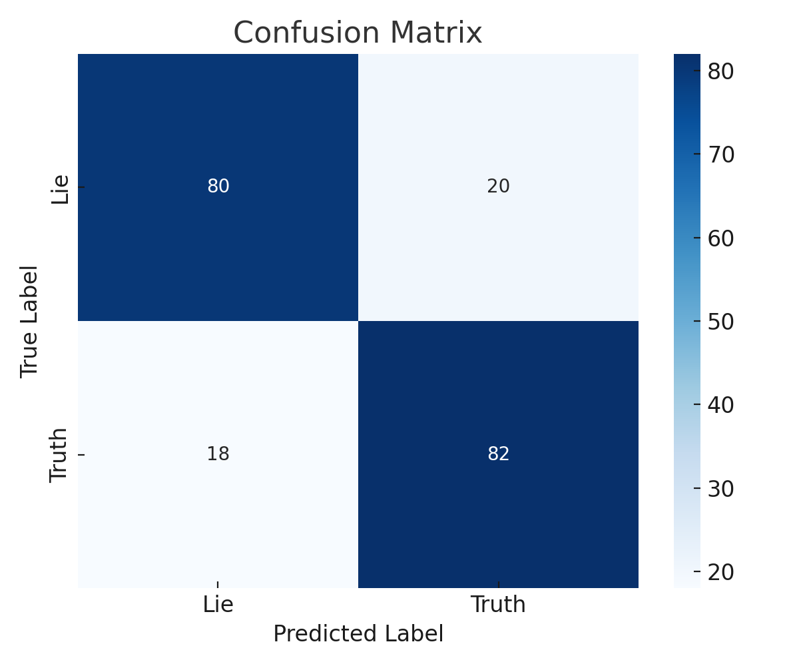
Model Performance Metrics
Precision
85.12% accuracy on identifying true positives
Recall
82.12% sensitivity to detect actual deception cases
F1-Score
Balanced 83.98% measure of precision and recall
Validation
No uncertain predictions in real-time testing indicate confident decision-making.

Slide 9
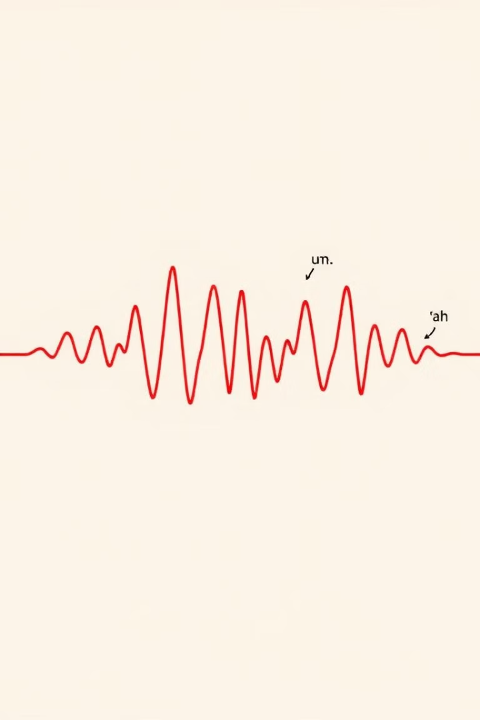
Dynamic Thresholding Logic
1
Speech Irregularities Components
2
Truth Threshold
Prediction score > 0.6 minus 0.2 times speech irregularities
50% fillers, 25% pitch variance, 25% loudness RMS
3
Lie Threshold
Prediction score < 0.4 minus 0.2 times speech irregularities
ADD

Slide 10
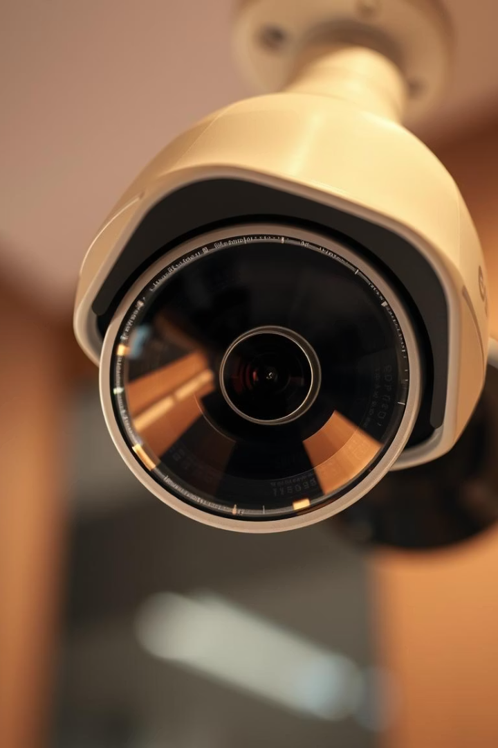
Limitations & Future Enhancements
Short video clips may miss subtle late deception signals. Gender imbalance in the Dolos dataset risks model bias. Varying lighting conditions impact detection accuracy. Planned improvements include an 'Uncertain' class, integration of heart rate data, and SHAP/LIME techniques for explainability.
ADD

Slide 11
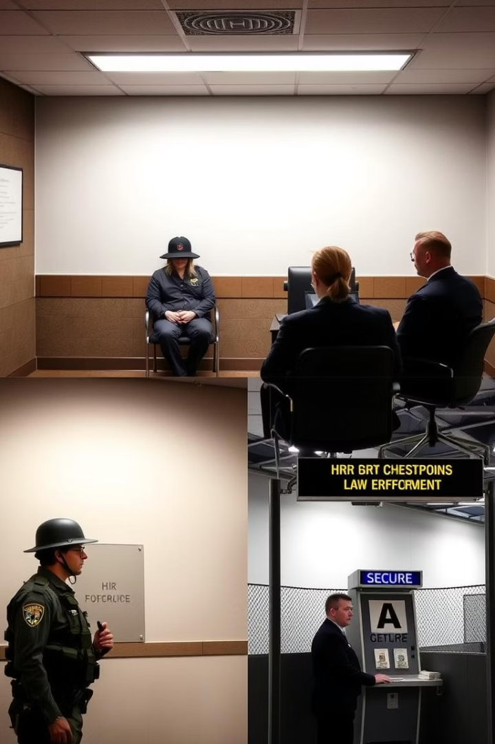
Applications & Real-world Use
Core Applications
Job Interviews and HR screening
Law Enforcement Interrogations
Online Exams and Border Security
Future Developments
API and cloud-based deployment
Mobile platform support
Fairness-aware AI to mitigate bias
ADD

Slide 12
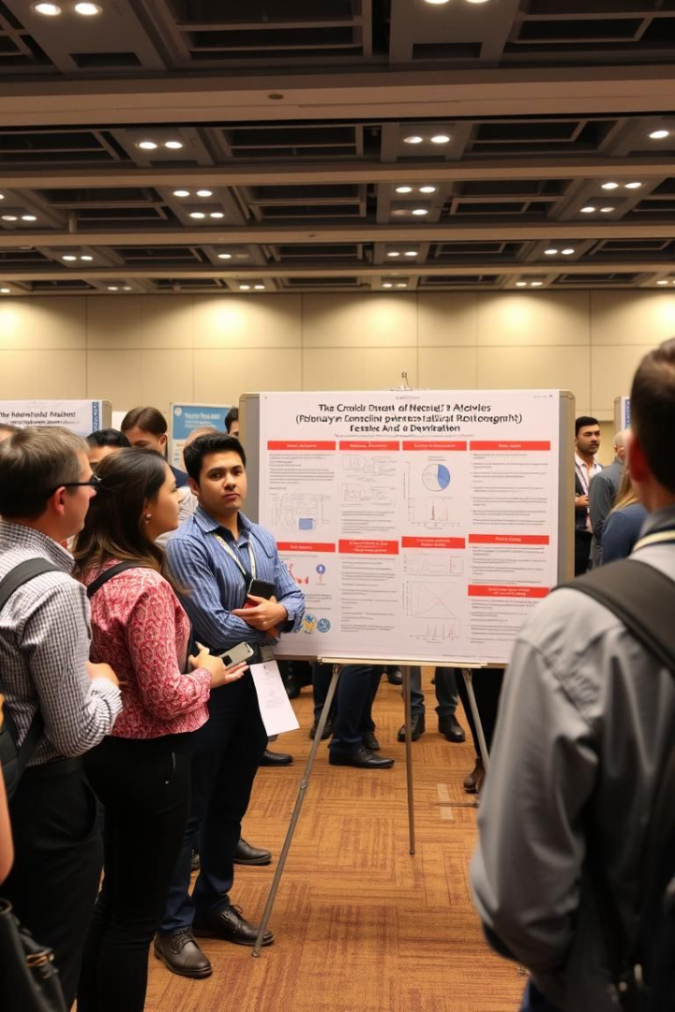
Thank You
Contact Information
For details, reach out to the project authors.
Project Affiliation
Real-time Multimodal Deception Detection Project
Institution
NMIMS, Navi Mumbai
ADD

